Slide 1
Delegates
Delegates are similar to function pointers in c++
It is a mechanism by which methods can be passed as method parameters instead of data.
But unlike C’s function pointer, delegates are type-safe and object oriented.
Delegates are used to implement call-backs.
A method can call another method through the delegate that is passed to it . This is known as an asynchronous callback.
Like class and interface it is also a type and its references are also created and instantiated.
A Delegate is an object that refer to a method.
Delegates are general-purpose mechanism for indirectly calling methods at runtime.
When we call a Delegate all the methods associate with the Delegate object will executes.

Slide 2
Delegates
To implement delegate in our application we need to declare delegates, instantiate delegates and call delegates.
We can declare delegates by using delegate keyword.
Declaration:
access-modifier delegate return-type delegate-name(parameter-list);
Ex: delegate void Mydelegate(string s);
Instantiation
delegate-name object-name=new delegate-name(method-name)
Or
delegate-name object-name=method-name
Invocation
object-name();
Note: The delegate can refer to the methods, which have the same signature and return type of the delegate .

Slide 3
Types of Delegates
Delegates are two types.
Single- cast Delegate
Multi cast Delegate

Slide 4
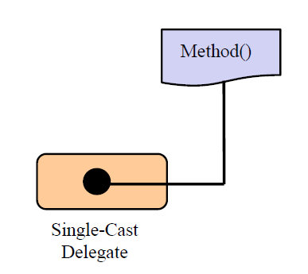
Types of Delegates[Contd.]
Single cast Delegate:
Single-cast delegate refer to one method at a time.
A single-cast delegate derived from System.Delegate class

Slide 5
Multicast Delegate
A Multicast delegate can invoke multiple methods at same time.
A Multicast delegate refers from the System.MulticastDelegate Class
When a multicast delegate is called ,it executes all the methods it wraps in the calling order.
The methods called by the multicast delegate should not have a return value.

Slide 6
Multicast Delegate
add a method to the delegate object , you simply make use of the overloaded += operator.
remove a method from the delegate object you make use of the overloaded operator -=
multicast delegates calls a sequence of methods in the specified order.
If one of the methods in the sequence throws an exception, the iteration stops there!

Slide 7
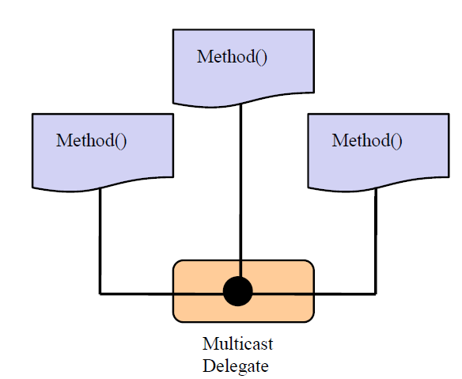
Multicast Delegate

Slide 8
Delegates
why delegates:
Delegates are type-safe
In Event handling mechanism to know which method to call when the event occurs.
In multithreaded programming to supply the starting point of the thread execution.

Slide 9
Events
An event is a way by which an object (publisher) can intimate/notify any other objects (subscribe) when some interesting thing happens to it.
Events are declared using delegates.
Events happen when a control is used by a user in a C# Windows Forms or Web application.
The form or the web application first has to subscribe to events raised by controls such as buttons and list boxes.
The Delegate used to write up such an event is called EventHandler delegate.
The following objects are used in the event model:
Publisher: Contains the definition of the event and delegate.
Subscriber: Accept the event and provides a handler to the event. The delegate of the publisher class invokes the method of the subscriber class.

Slide 10
Events
Declaration:
event eventhandler-delegate event-name;
eventhandler-delegate is the name of the delegate used in event declaration.
event-name is the name of the event object
Events can be declared as static and instance.
Once an event is declared, it must be associated with one or more event handlers before it can be raised.
An event handler is nothing but a method that is called using a event
The events are declared and raised in one class and associated with the event handlers using delegates with in the same class or other class.

